Slide 1


Slide 2


INTRODUCTION
Blinkit is a leading online grocery delivery service in India, known for its lightning-fast delivery times. Formerly known as Grofers, the company rebranded to reflect its commitment to delivering essentials in the blink of an eye. Founded in 2013, Blinkit has revolutionized the way people shop for groceries by offering a wide range of products, from fresh produce to household essentials, right at your doorstep.

Slide 3

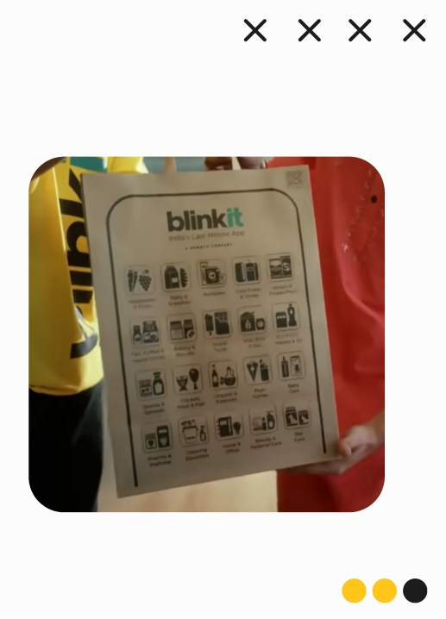
BUSINESS REQUIREMENTS
To conduct a comprehensive analysis of Blinkit's sales performance, customer satisfaction, and inventory distribution to identify key insights and opportunities for optimization using various KPIs and visualizations in Power BI.
KPI's Requirements:
* Total Sales: The overall revenue generated from all items sold.
* Average Sales: The average revenue per sale.
* Number of Items: The total count of different items sold.
* Average Rating: The average customer rating for items sold.

Slide 4
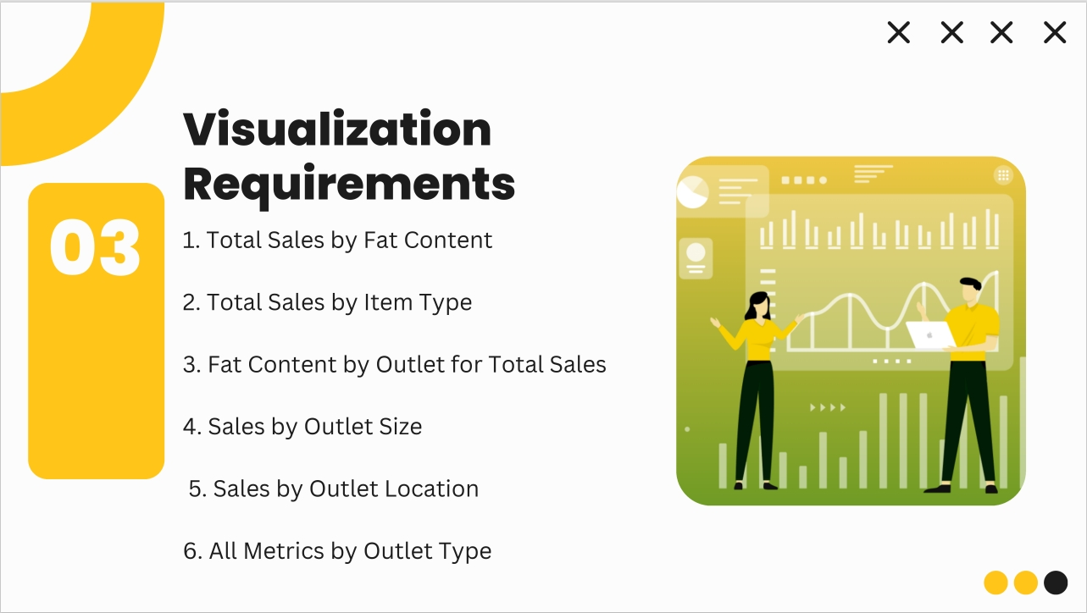

Slide 5
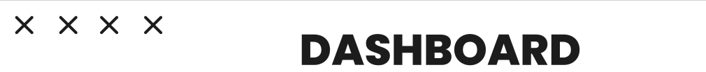

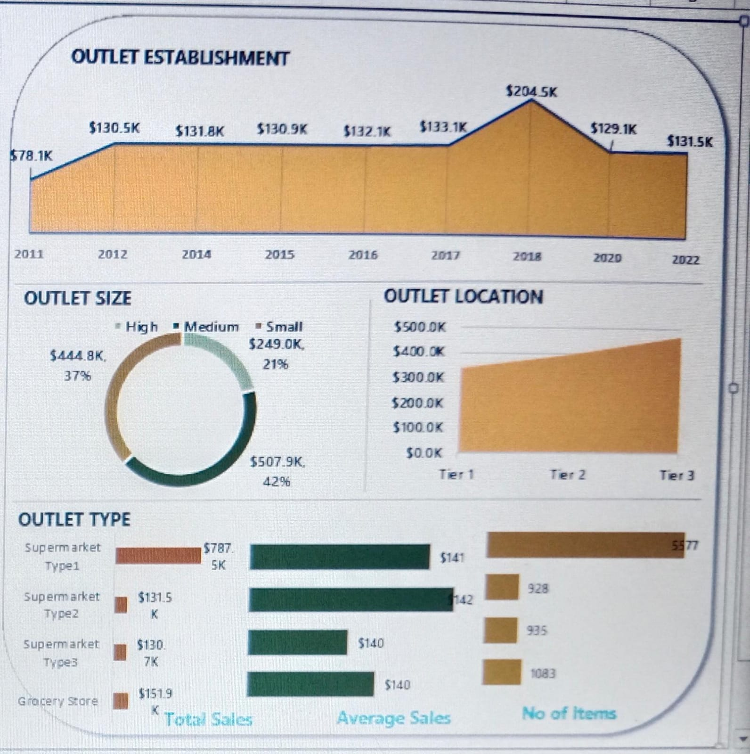

Slide 6

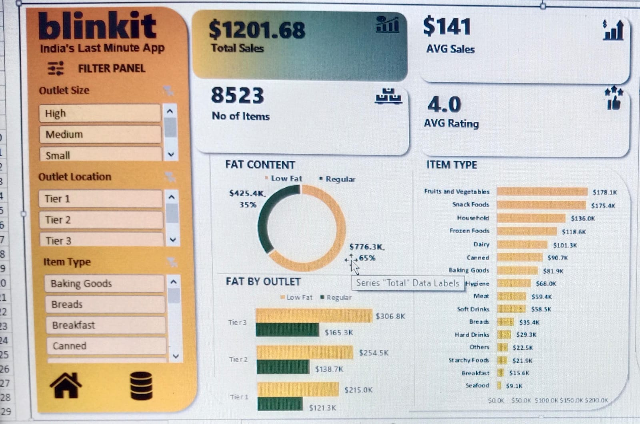

Slide 7
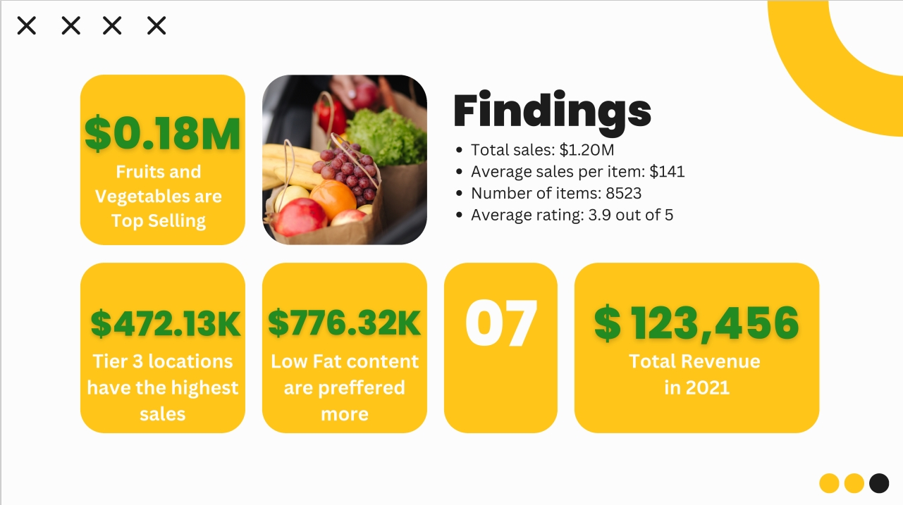

Slide 8


Slide 9


